Slide 1
CS439 Intro data science recitation I
TA: Wenyi Mo

Slide 2
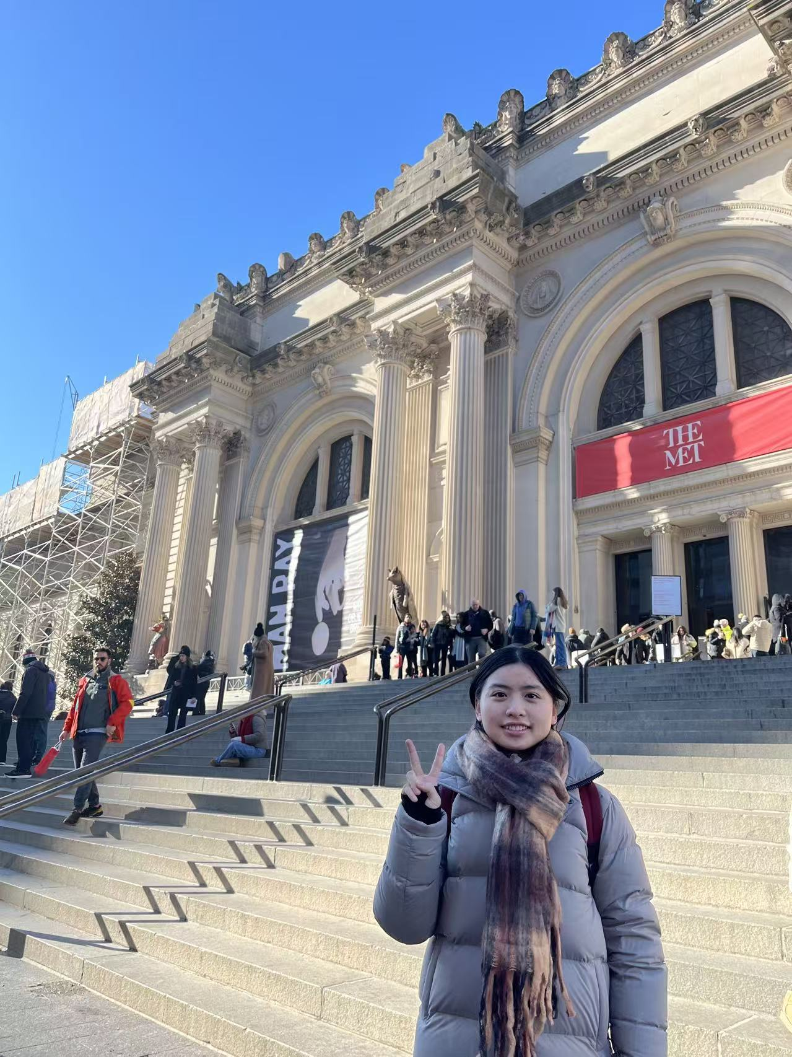
Self Introduce
TA: Wenyi Mo
Email: wm397@scarletmail.rutgers.edu
Info:
Second-year PhD student
Research topic: Reinforcement Learning at CBIM group
Language: Python
Office Hour: Monday 10:00 AM –11:00 AM

Slide 3
Take attendance

Slide 4
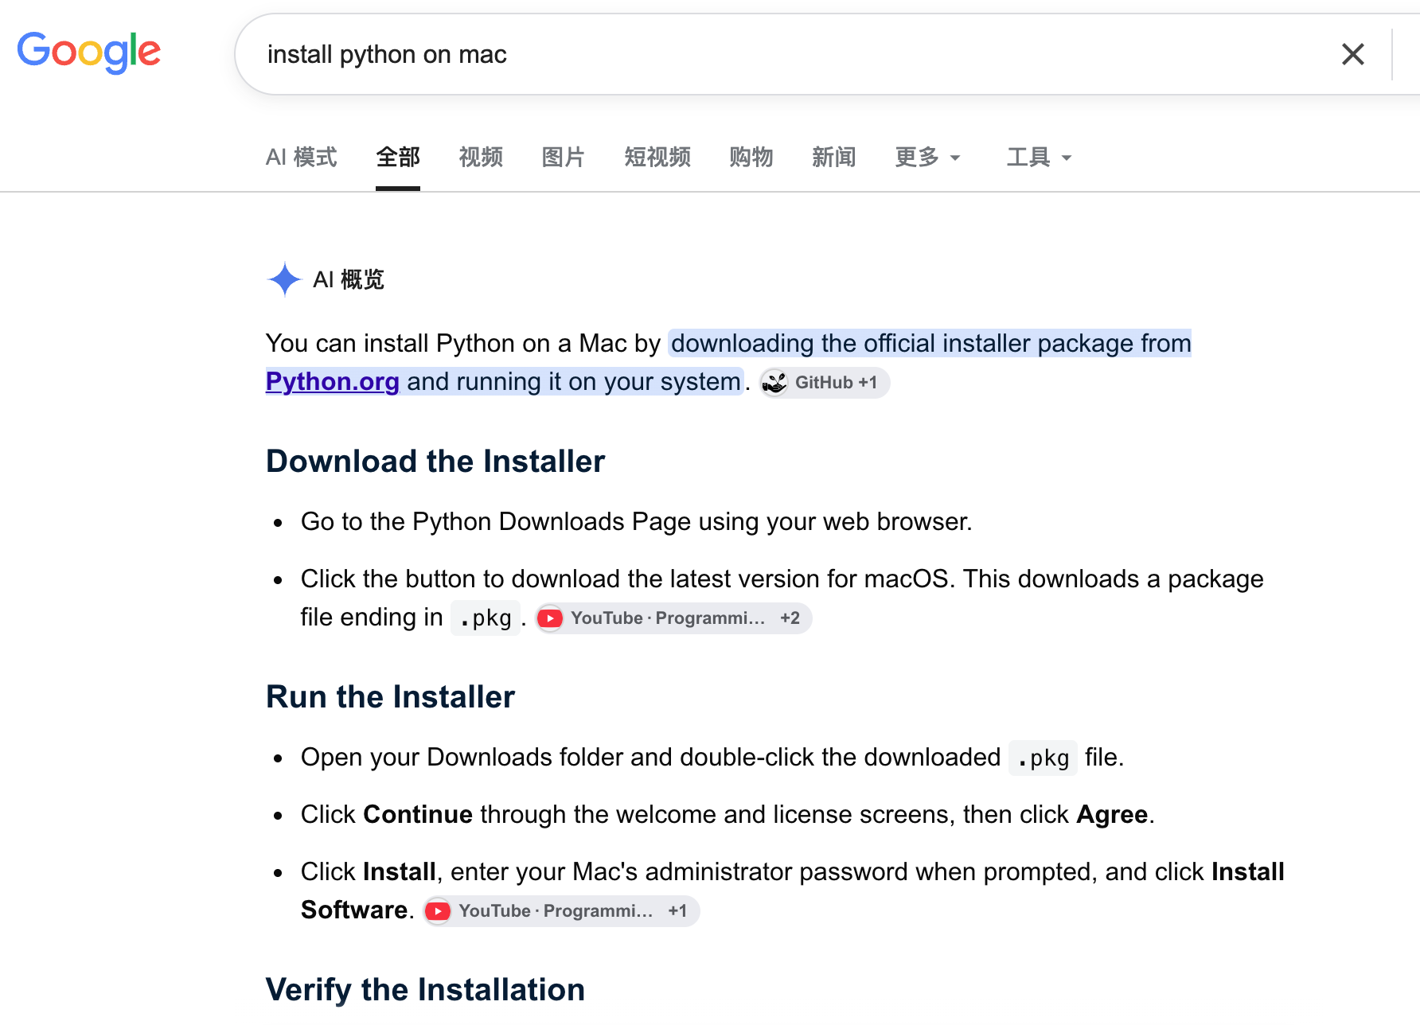
Setup Python
A quick introduction of Python
Keypoint: interpreted language, easy-to-use

Slide 5
Setup Python libraries (e.g. Numpy, matplotlib)
Installation:
Installation using conda, or pip
Show how to use the installed libraries

Slide 6
Introduction to Numpy

Slide 7
Introduction to matplotlib

Slide 8
Q & A
Email: wm397@scarletmail.rutgers.edu

Slide 9
Thank you

